Slide 1
Nonsynonymous mutation
Calculating TMB & TTR

Slide 2
Synonymous Mutations
Synonymous mutations are point mutations, meaning they are just a miscopied DNA nucleotide that only changes one base pair in the RNA copy of the DNA. A codon in RNA is a set of three nucleotides that encode a specific amino acid. Most amino acids have several RNA codons that translate into that particular amino acid. Most of the time, if the third nucleotide is the one with the mutation, it will result in coding for the same amino acid. This is called a synonymous mutation because, like a synonym in grammar, the mutated codon has the same meaning as the original codon and therefore does not change the amino acid. If the amino acid does not change, then the protein is also unaffected.
Synonymous mutations do not change anything and no changes are made. That means they have no real role in the evolution of species since the gene or protein is not changed in any way. Synonymous mutations are actually fairly common, but since they have no effect, then they are not noticed.

Slide 3
Nonsynonymous Mutations
Nonsynonymous mutations have a much greater effect on an individual than a synonymous mutation. In a nonsynonymous mutation, there is usually an insertion or deletion of a single nucleotide in the sequence during transcription when the messenger RNA is copying the DNA. This single missing or added nucleotide causes a frameshift mutation which throws off the entire reading frame of the amino acid sequence and mixes up the codons. This usually does affect the amino acids that are coded for and change the resulting protein that is expressed. The severity of this kind of mutation depends on how early in the amino acid sequence it happens. If it happens near the beginning and the entire protein is changed, this could become a lethal mutation.
Another way a nonsynonymous mutation can occur is if the point mutation changes the single nucleotide into a codon that does not translate into the same amino acid. A lot of times, the single amino acid change does not affect the protein very much and is still viable. However, if it happens early in the sequence and the codon is changed to translate into a stop signal, then the protein will not be made and it could cause serious consequences.

Slide 4
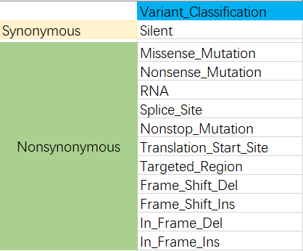
Data in the GDC portal
Common type
搜了几篇文献没有看到TMB具体的计算步骤，只是指明了为编码区非同义突变的数量
通过整理各突变定义(见附件Excel)我认为可粗略这么划分
TMB的定义及包含哪些突变由老师来定

Slide 5
END

Slide 6
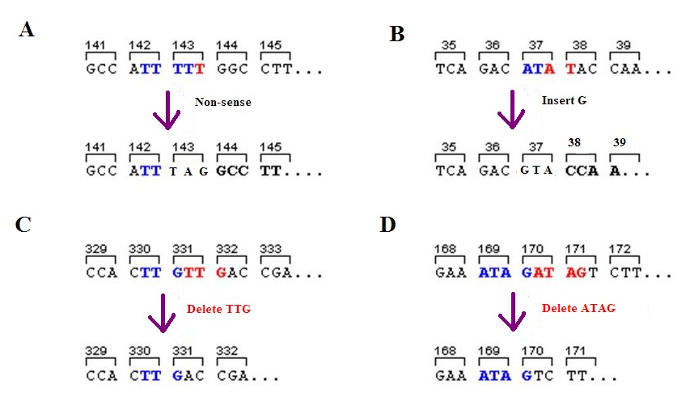
Supplementary Fig
Different types of indel mutation. Panel C is simply a deletion and not a frameshift mutation.

